Slide 1
Critical Problems Encountered During Summer Testbeams
Matt Hollingsworth

Slide 2
Hardware Problem #1: High sensitivity to digital voltage
Entire system doesn’t work at all unless it gets some ideal voltage
As little as 100 mV of change can prevent the system from working at all
Works sometimes, then dies for hours at a time, only to come back spontaneously later
Temporary fix: Sense voltage at the connector--t’ing off in wire didn’t work
Still dies randomly (in one of the ways described on following slides) on a timescale of 10 hours

Slide 3
Hardware Problem #2: “Spontaneous DOH Reset”
Not necessarily sure that it is actually a DOH reset
Symptoms:
System runs stably for relatively long period of time
Scope trace suddenly drops to 0
Powerup script sometimes brings it back, sometimes does not
Power cycle fixes

Slide 4
Hardware Problem #3: HV Bias Questionable
There were periods where the diamonds themselves seemed to die
Fast-Ors worked for a long period of time and then went completely silent
Resolution: Put resistor from shield of HV to closest metal structure—diamond came back to life
Perhaps a misunderstanding of the CAEN grounded vs. floating scheme?

Slide 5
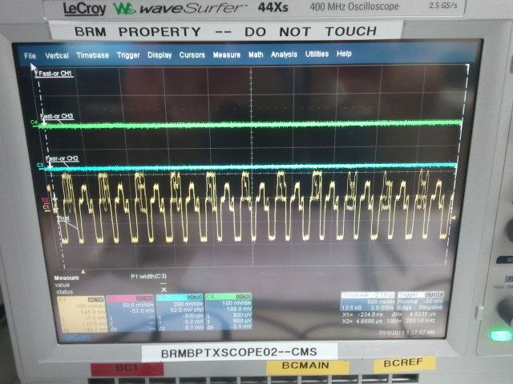
Hardware Problem #4: “Cyclic TBM Failure State”
Can happen anytime, not necessarily only when sending commands
Sometimes seems to trigger a DOH reset
I observed this with the electrical setup also last year; TBM reset and ROC reset fixed it
Didn’t try these at test beam, since most of the time, a DOH reset was sent shortly after
Observation: this state seems to occur when CAEN is ramping down for a power cycle

Slide 6
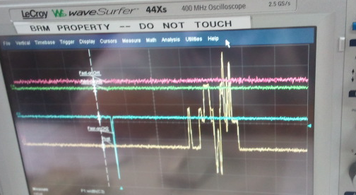
Hardware Problem #5: Strange TBM State
Occurs often as part of startup procedure (not a problem when it happens here)
Also occurs in the middle of data taking (is a problem)
Sometimes powerup script works, sometimes power cycle required, sometimes neither fixed it
In this state, Fast-OR continues to work fine

Slide 7
Hardware Problem #6: Not enough fully operational AOH’s
Nearly none of the AOHs we had available were 100% working
Need more if we’re going to actually readout a full cassette
DOH was possibly flakey too (still don’t understand the source of “spontaneous DOH resets”)

Slide 8
Software Problem #1: Interface still requires expert intervention
Lack of frontend makes it difficult to get up and running without having the people there who wrote the software
Need final versions of code and documentation to back them up
Need frontend—web interface would be nice

Slide 9
Software Problem #2: No “Database” of DACs for ROCs
Need a set of automatically loaded DAC files with optimized settings for each ROC
Critical settings which differ largely from ROC to ROC (and are probably relatively solid):
CalDel
Vthresh
Vtrim
VbiasPH
Ibias_ROC
We should optimize these by hand once and for all and keep up with the result (happens a few times per test beam right now)
Need to define targets for each of these settings
Ibias_ROC: Address levels at X mV above baseline
CalDel: ROC responds to cal pulses from Vcal = 40 (low) to Vcal = 120 (high)
etc.
Write calibrations for these only if we find it necessary

Slide 10
Software Problem #3: No Trimming
Trimming didn’t work for us
Took Deans code (based on GainCal) and made modifications until it worked
Suggest we use this method (faster and can re-analyze later)
Never got “pretrimming” working
No standard way to automatically load trim maps once they’ve been created
Nearly all calibrations overwrite them

